Slide 1
Use Jupyter when started from openBIS
Step by Step documentation and a short example
Stefanie Hauser @ Scientific IT

Slide 2
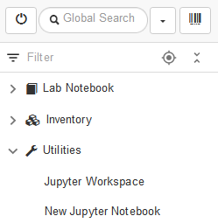
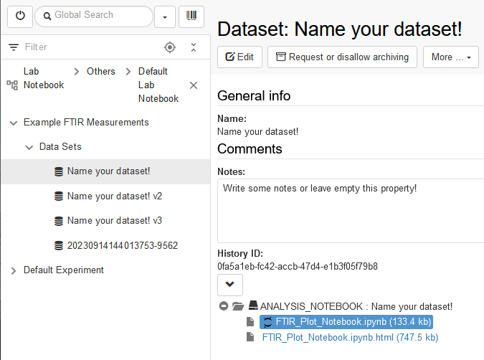
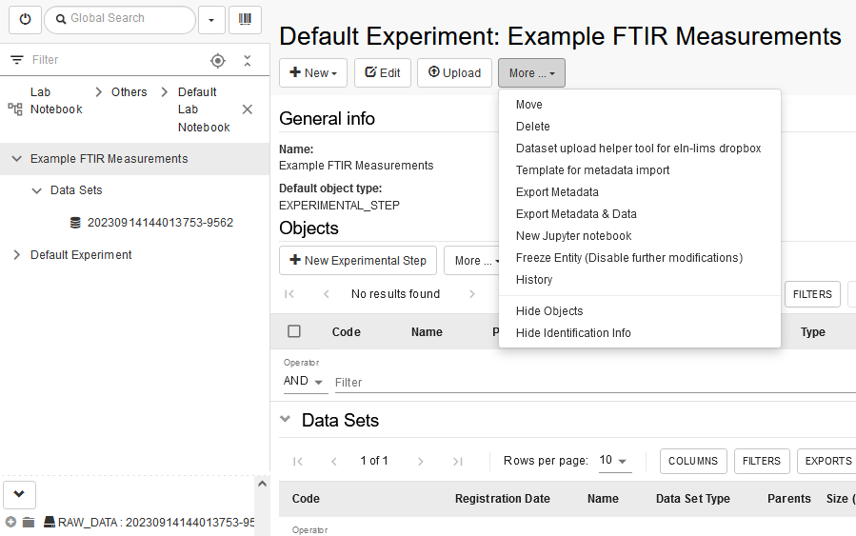
Four ways to find Jupyter in openBIS
Utilities:
1. Jupyter Workspace
To open your workspace with directories
2. New Jupyter Notebook
To create a new jupyter notebook with any data to choose
1.
2.
4.
From Experiment/Object:
3. New Jupyter Notebook
To create a new jupyter Notebook with data from experiment/object already chosen
3.
From Dataset with Notebook
4. Existing Jupyter Notebook
Click on the black jupyter icon to open in your Jupyter Workspace

Slide 3
Create new Jupyter Notebook gives two options
Options:
Create & Connect to work on the server
Create & Download to work locally on your computer
Both options will create a jupyter file with prefilled fields for working with openBIS
Dont forget:
Pop ups needs allowance

Slide 4
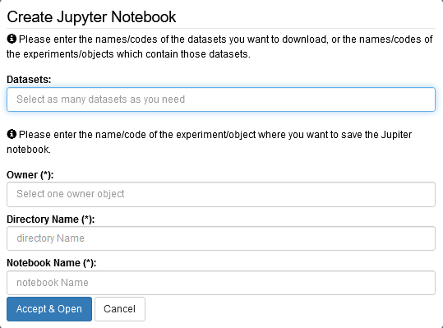
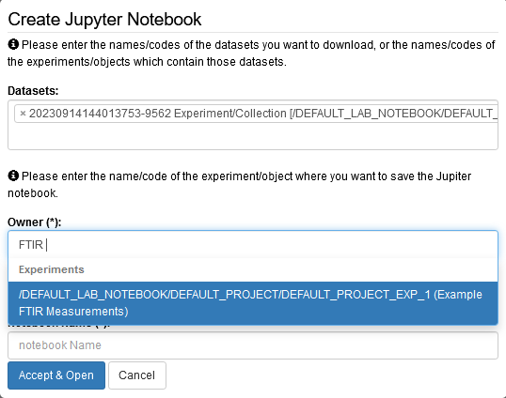
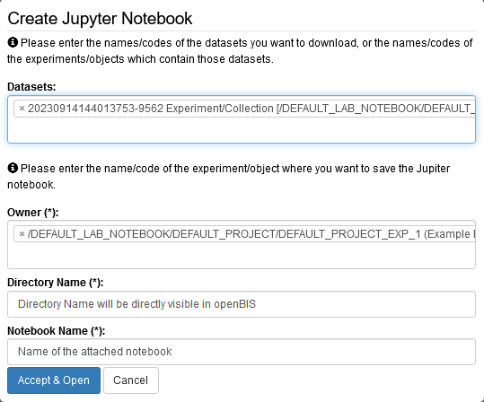
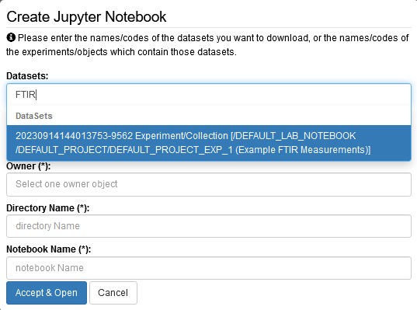
Create new Juypter Notebook from Utilities
Empty when created in Utilities
Choose datasets you want to process in your Jupyter Notebook
Choose place where you want to save the Jupyter Notebook or additional Data afterwards
Directory and Notebook are individually given

Slide 5
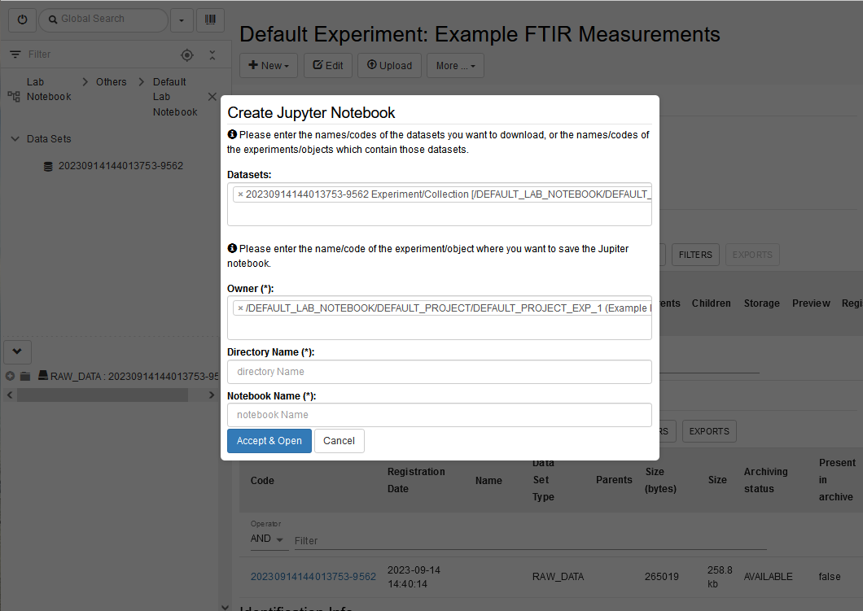
Create new Jupyter Notebook from Collection/ Object
Not empty when created in Object/Collection
The field for datasets contains Datasets from the Collection/Object
More can be added
The field for Owner contains the Collection/ Object from where the Jupyter notebook is created
Can be changed
Directory and Notebook name have to be added

Slide 6
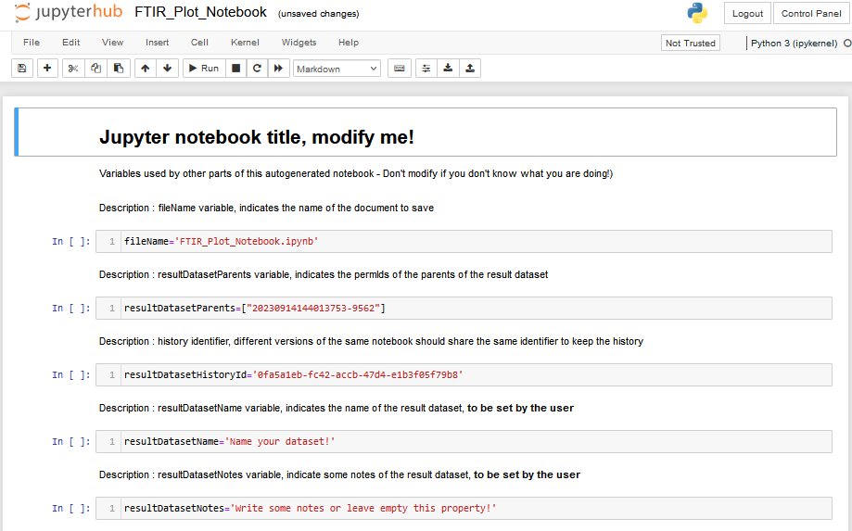
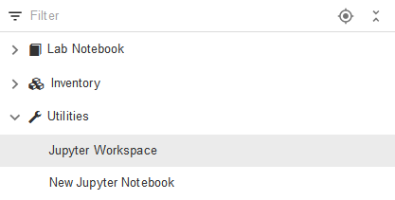
Accept & Open
Pop ups needs allowance
New Window opens with Jupyter notebook
Notebook is now visible in Jupyter Workspace

Slide 7
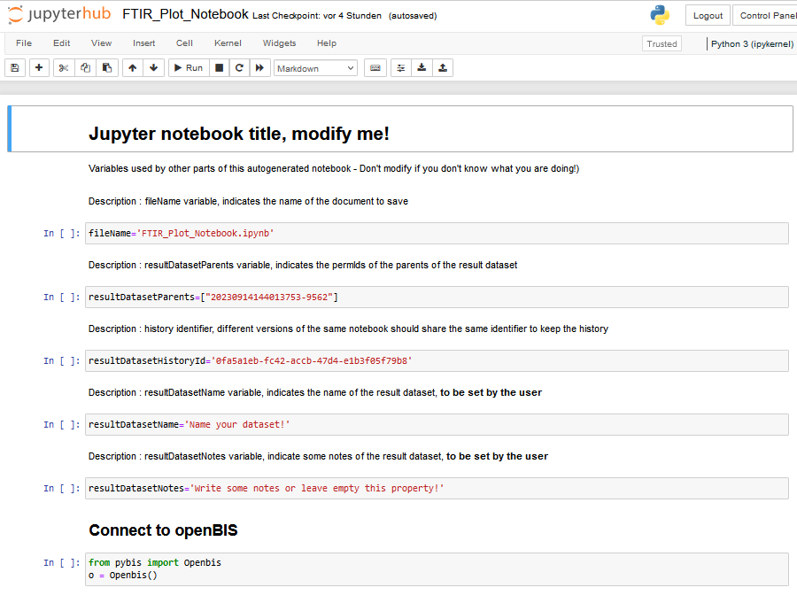
1) Jupyter Notebook: assign variables
The variable fileName and the Notebook name, needs to be the same
Jupyter Notebook Title is only displayed inside the notebook
The variable resultsDatasetParents contains the permID of the rawdata that was chosen when starting the notebook (check slide 4, choosing dataset)
The variable resultsDatasetName will be the name, that is given to the new dataset created by this Jupyter Notebook, the variable resultsDatasetNotes belongs to it.
1.
2.
1.
3.
4.
4.

Slide 8
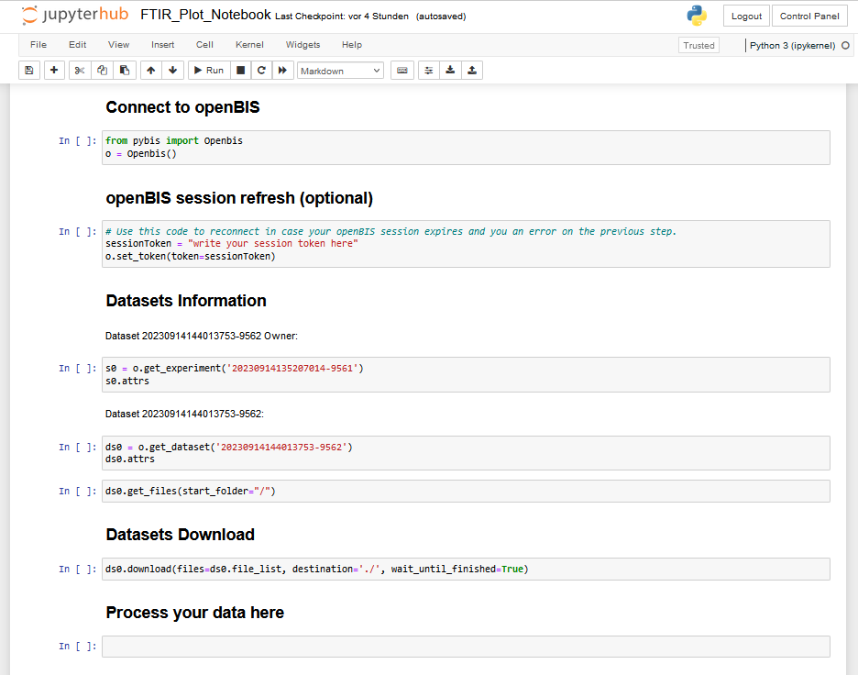
2) Jupyter Notebook: import data
pyBIS is a Python module to interact with openBIS (https://pypi.org/project/PyBIS/)
In openBIS ELN – Utilities – User Profile you get your Session Token
Get info from the chosen dataset (slide 4) and Download it to your Jupyter Workspace for further processing
Process your data, like open and plot. Script can be of any length and any number of cells can be added
5.
6.
7.
8.

Slide 9
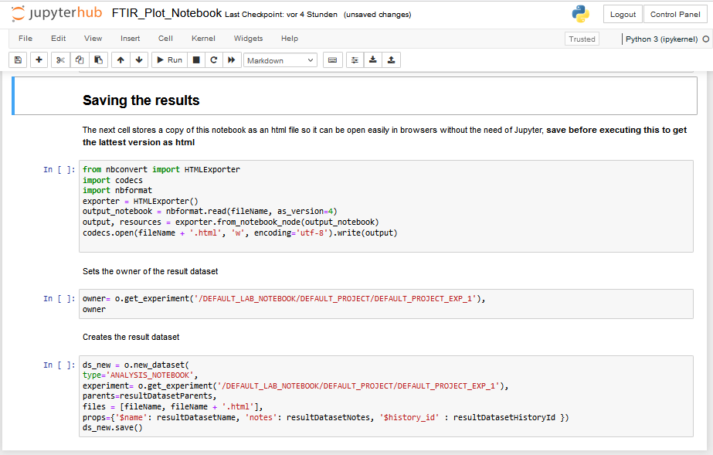
3) Jupyter Notebook: Save Data
The HTML file is like a pdf, to display without editing. You can also directly copy plots from there.
Owner was chosen in the beginning (slide 4), run this code shows metadata about Experiment where notebook is saved in
Run this code to save the current notebook and a HTML file of it in the owner directory.
9.
10.
11.

Slide 10
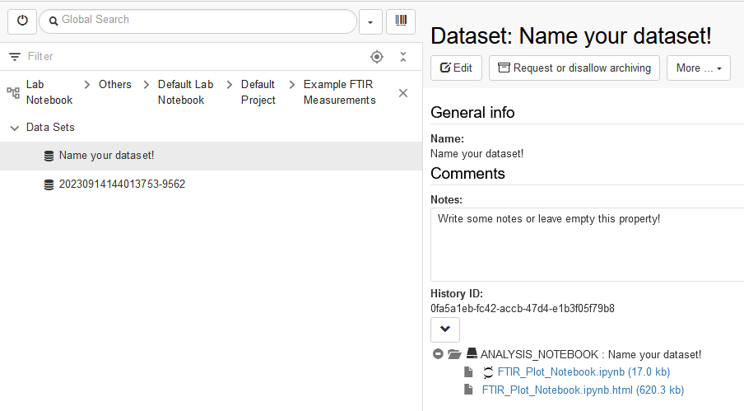
Jupyter notebook vs. openBIS ELN after data saving
1.
3.
5.
3.
3.
1.
2.
4.
2.
5.
5.
3.
1.
4.
6.
1. Name of Jupyter Notebook
2. PermID of Dataset to process
3. Name of Dataset with attached Jupyter Notebook
4. Notes in Dataset with attached Jupyter Notebook
5. HistoryID for Versioning
6. To open this Jupyter Notebook new in Workspace

Slide 11
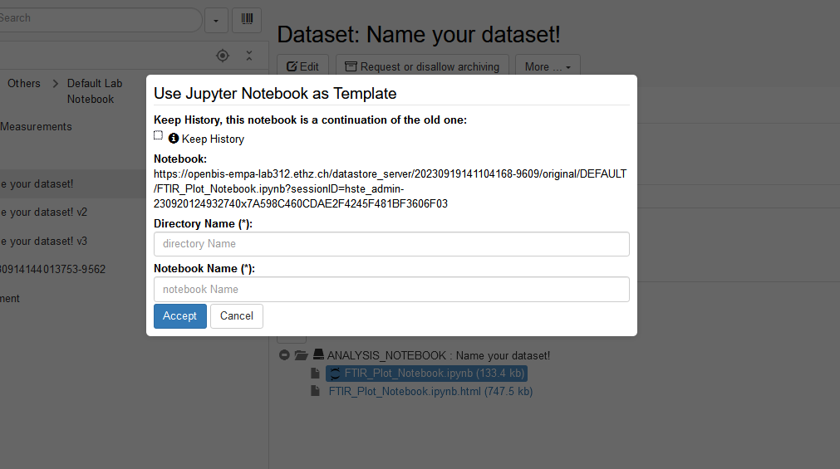
Create existing Jupyter Notebook from Dataset attachment
Click on the Jupyter symbol
Clicking on the name of the notebook will open the download dialogue for the attachment
Keeping the History will make sure, that related notebooks are connected to each other
Via parent-child relation
Add Directory and Notebook Name as always

Slide 12
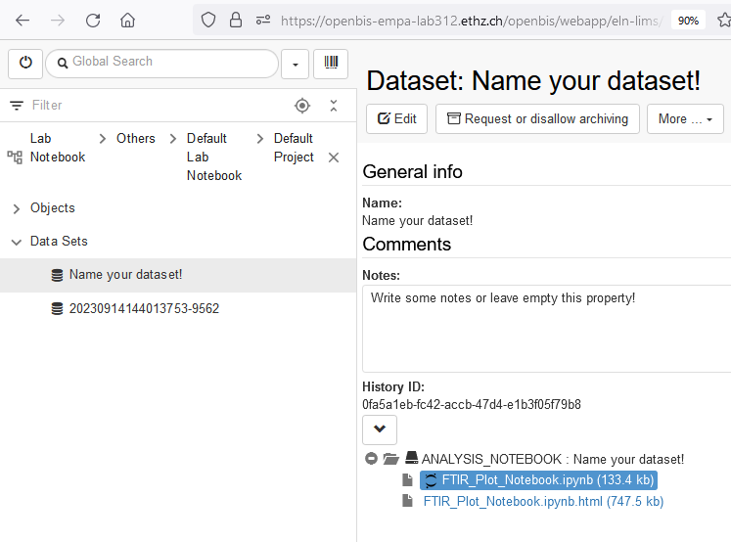
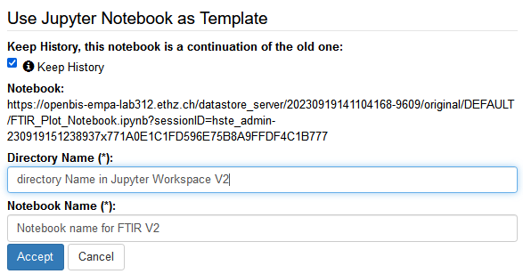
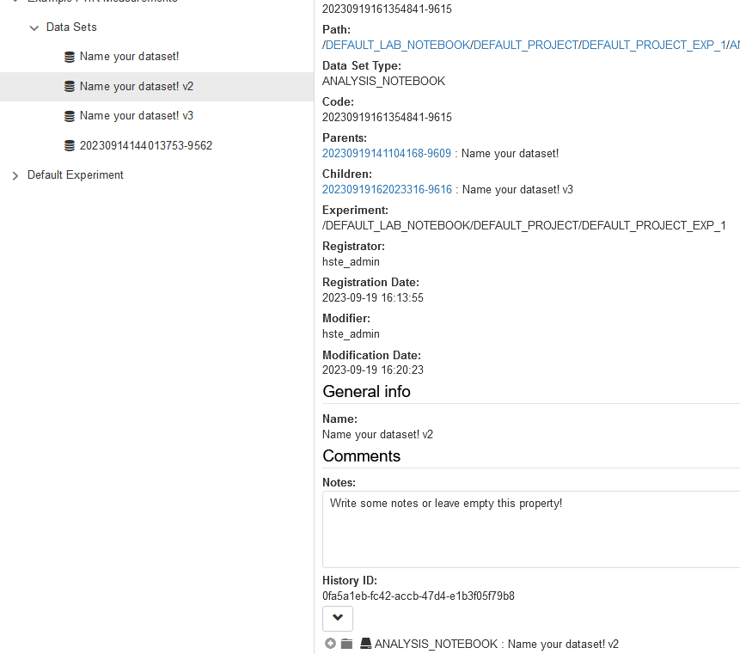
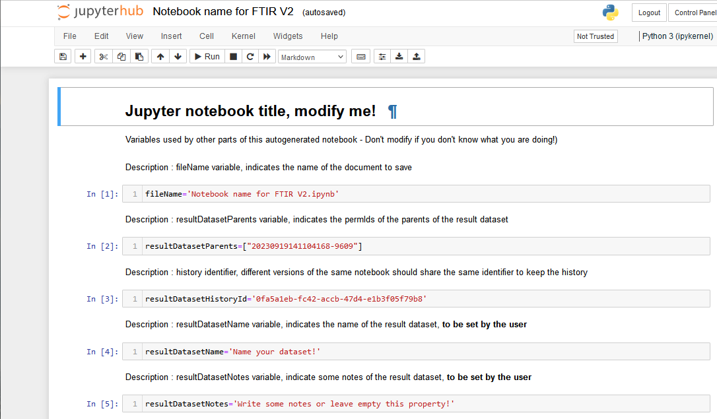
History ID
Create a new Dataset with a Juypter Notebook will give an openBIS entity of type Dataset with a new PermID
Choosing the same History ID for the Dataset will connect them in a parent child relation
It’s possible to have a versioning like that
Open
Keep History and Accept
Versioning
Save changed Notebook back to openBIS

Slide 13
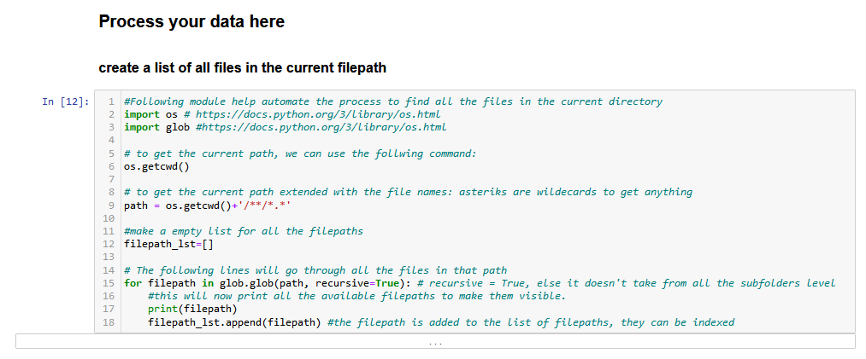
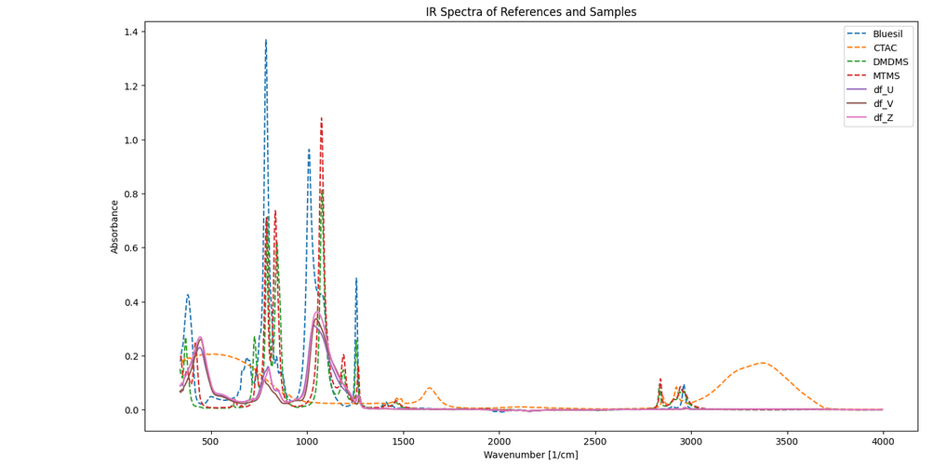
Process your data here: example of a plot

Slide 14
Questions?
openBIS
Instance Admin of your group if you are a User @ Empa
openBIS-support@empa.ch if you are an Instance Admin @ Empa
OpenBIS documentation for Empa specific cases https://scientificit.empa.ch/openbis/
Official OpenBIS page from ETH https://openbis.ch/
Python
We are currently building up Python Hours at Empa for support regarding programing with python – More information will follow (edoardo.baldi@empa.ch )
Scientific IT
Webpage for scientifit IT just launched
https://scientificit.empa.ch/ (Webpage still under construction)

